Slide 1

Self-supervised Classification of Clinical Multivariate Time Series using Time Series Dynamics
Data Mining presentation P14
December 20th , 2023
Irene Dovichi, Giacomo Lagomarsini, Alice Nicoletta

Slide 2




Presentation scheme
Introduction to the topic of the paper
Model description and implementation details
Background of Koopman theory
Experimental results

Slide 3
Introduction
The purpose is to improve the accuracy of multivariate time series classification with a novel self-supervised paradigm that captures the dynamics of MTS.
The study is conducted on clinical data and the time series are multivariate because they are obtained from a sequence of measurements coming from multiple sensors.
Theoretically grounded approach: Koopman theory allows us to project the complex and nonlinear dynamics of our time series into a linear space.

Slide 4
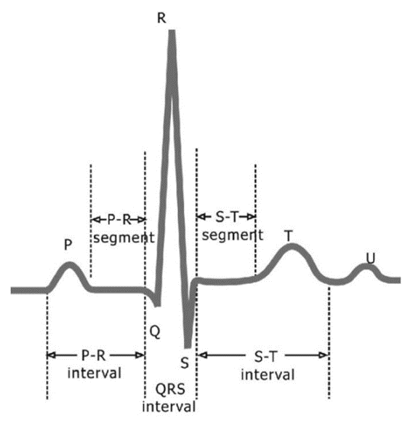
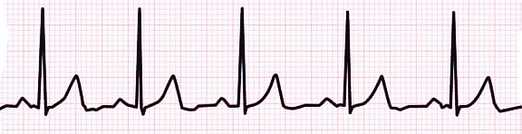
Electrocardiogram (ECG)
An electrocardiogram (ECG) is a test that records the electrical activity of the heart.
10 electrodes (12 leads), each lead generates a time series of data.
Duration of 10 seconds.
Sampling frequency of 500 Hz.
Combining the results of the different leads allows to infer cardiac activity and can help diagnose a variety of health conditions (arrhythmias, ventricular dysfunction, etc.)
^

Slide 5
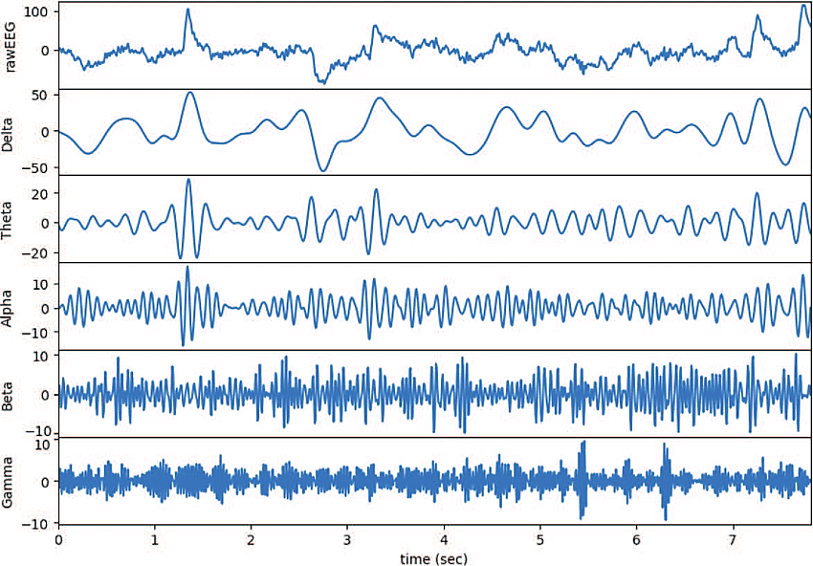
Electroencephalogram (EEG)
An electroencephalogram (EEG) is an electrical signal generated by the brain.
1-256 electrodes, each electrode generates a time series of data called channel.
Duration of 20-60 minutes.
From the raw EEG signal, specific frequency components are extracted:
Delta (< 4 Hz)
Theta (4-7 Hz)
Alpha (8-13 Hz)
Beta (14-30 Hz)
Gamma (> 30 Hz)
The analysis of the different frequency components and waveforms allows to identify various neurological conditions (epilepsy, sleep disorders, brain tumor, etc.)

Slide 6
Method
ECG and EEG signals can be modeled by ODEs.
ODEs describe the evolution of a system over time, often in terms of nonlinear functions. In many cases, solving nonlinear ODEs analytically can be challenging.
Koopman theory is a mathematical and dynamical systems framework used in the analysis of nonlinear systems.
Koopman theory offers a method to linearize the dynamics of a nonlinear system.
More specifically: we switch from a finite-dimensional nonlinear system to an infinite-dimensional linear one with the Koopman operator, which is an infinite-dimensional linear operator that acts on scalar observable functions by composition.

Slide 7






Koopman Theory
We focus on discrete-time dynamical systems since ECG and EEG data describes a continuous-time system sampled in discrete time:
with
Def. Given the Koopman operator for our dynamical system is
We observe that:
-
.
is linear:

Slide 8





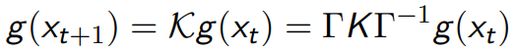



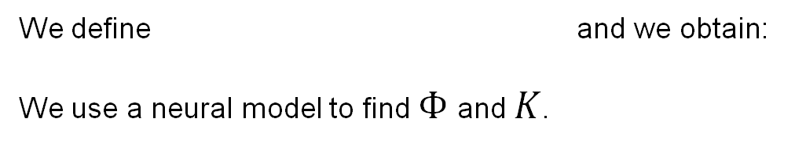
Learning Koopman Embedding
We want to find vvvvvvvvvvvvvvv a finite-dimension approximation of and s.t.
Notice that:
We can rewrite the equation of the system as:
We define and we obtain:
We use a neural model to find $Φ$ and $K$.

Slide 9
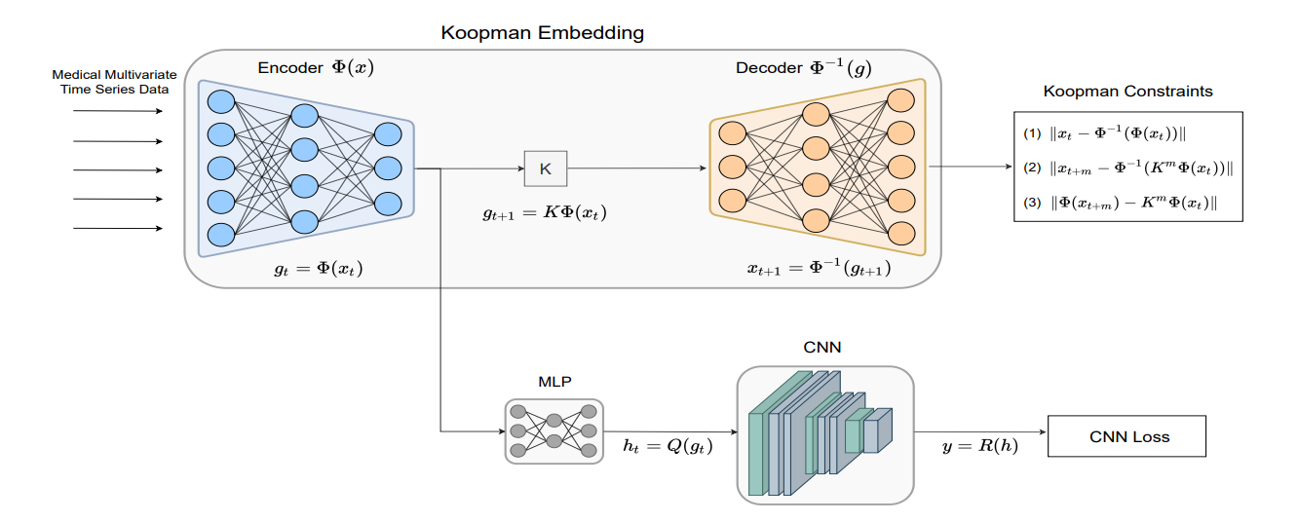
Model

Slide 10
Model
The encoder $Φ$ encodes $x_{t}$ into the Koopman embedding space $G$.
In formula, $Φ\left(x_{t}\right)=g(t)$.

Slide 11
Model
2a. In the Koopman space, the dynamic is linear: $K$ is a singe matrix, and
$g_{t+1}=Kg_{t}$.

Slide 12
Model
3a. The decoder $Φ^{−1}$ brings $g_{t+1}$ back to the original space.
In formula, $Φ^{−1}\left(g_{t+1}\right)=x_{t+1}$.

Slide 13
Model
2b. The encoded input $g_{t}$ also passes into a Feedforward Neural Network, which e extracts useful features for classification $h_{t}=Q(g_{t})$

Slide 14
Model
3b. Finally, the sequence of features $[h_{1},…,h_{t},…h_{T}]$ is passed through a N cddConvolutional Neural Network, that outputs the classification results

Slide 15
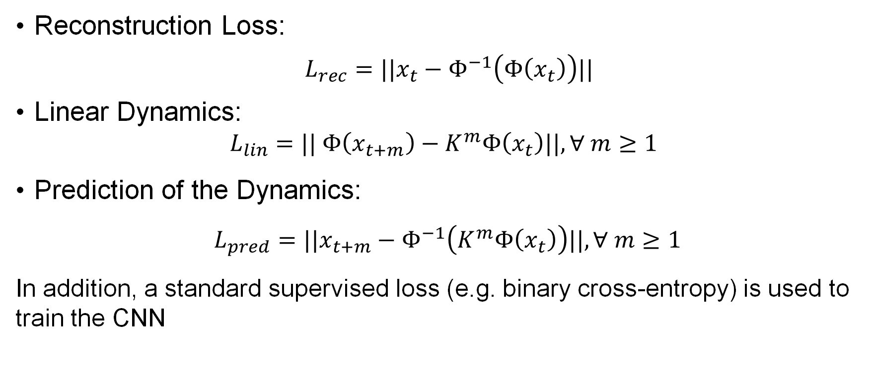
Losses of the model
In order to learn the correct linearization of the dynamics, we need a combination of three loss functions.
Reconstruction Loss:
$L_{rec}=||x_{t}−Φ^{−1}\left(Φ\left(x_{t}\right)\right)||$
Linear Dynamics:
$$L_{lin}=|| Φ\left(x_{t+m}\right)−K^{m}Φ\left(x_{t}\right)||, ∀ m≥1$$
Prediction of the Dynamics:
$L_{pred}=||x_{t+m}−Φ^{−1}\left(K^{m}Φ\left(x_{t}\right)\right)||, ∀ m≥1$
In addition, a standard supervised loss (e.g. binary cross-entropy) is used to train the CNN

Slide 16
Datasets
ECG: two datasets
G12EC: 10344 12-lead ECGs from 7871 patients
PTB-XL: 21837 12-lead ECGs from 18885 patients
10 seconds, 500 Hz sampling frequence length of TS 5.000
Multi-Label classification task, up to 27 different diagnoses
We focus on the 6 most common anomalies
EEG: Temple University Hospital dataset
2,993 recordings,
various lengths, 21 channels with different frequencies
Binary classification task, normal or abnormal EEG

Slide 17
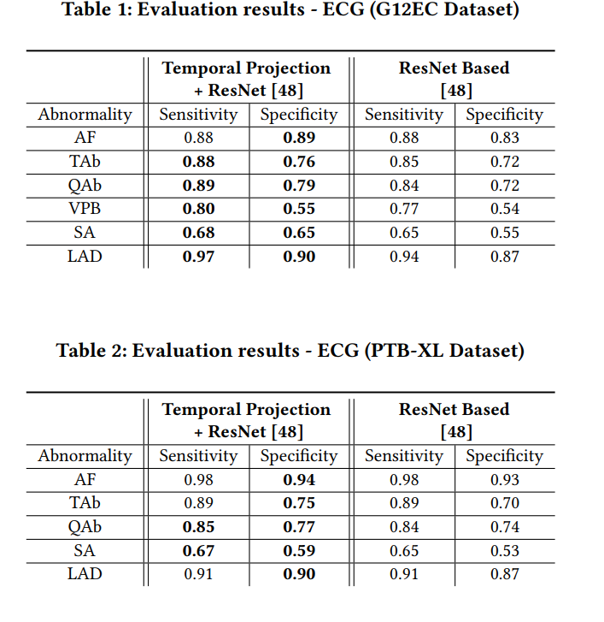

Results (ECG)
Compared against SotA, a ResNet CNN
Improvements in sensitivity and specificity of recognising almost every type of diagnosis.
All statistically significative results, p-value < 0.05

Slide 18
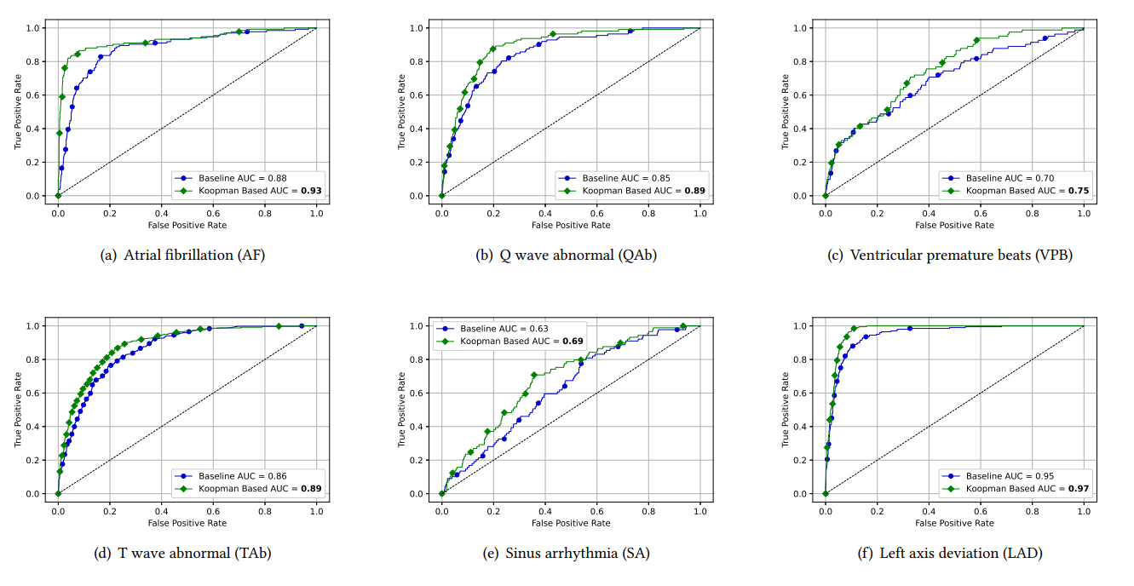
ROC Curves (ECG)

Slide 19
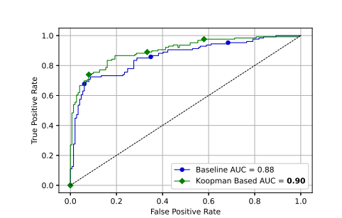
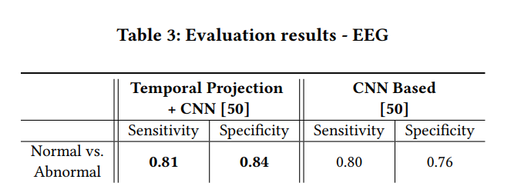
Results (EEG)
Previous SotA: Convolutional Neural Network
Huge improvement in specificity

Slide 20
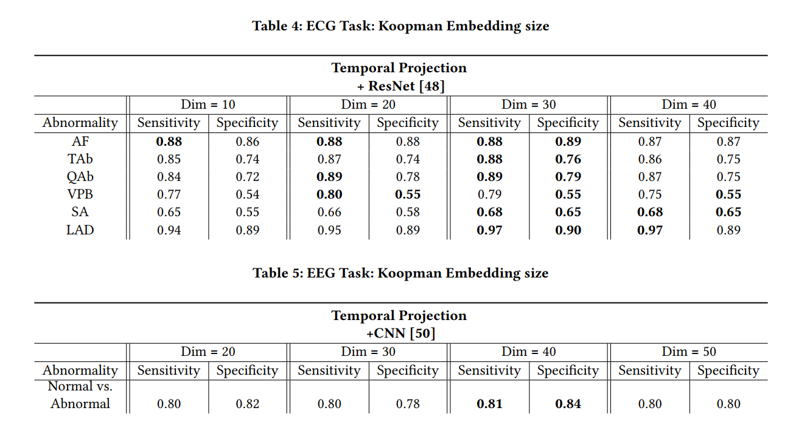
Dimension of the Embeddings
Choosing the right dimension for the embedding space is fundamental.
For the ECGs a dimension of 30 turns out to be the best, for the EEGs is 40.
Manually tune the hyperparameter for each task

Slide 21
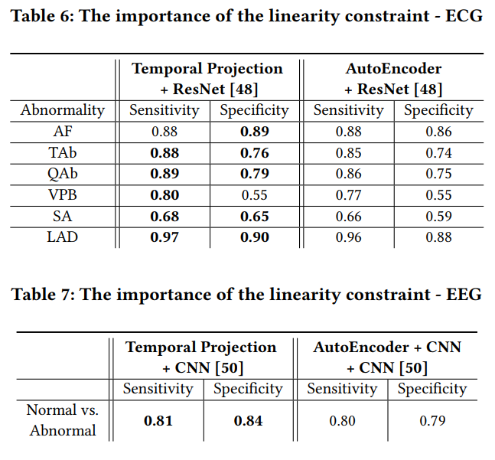
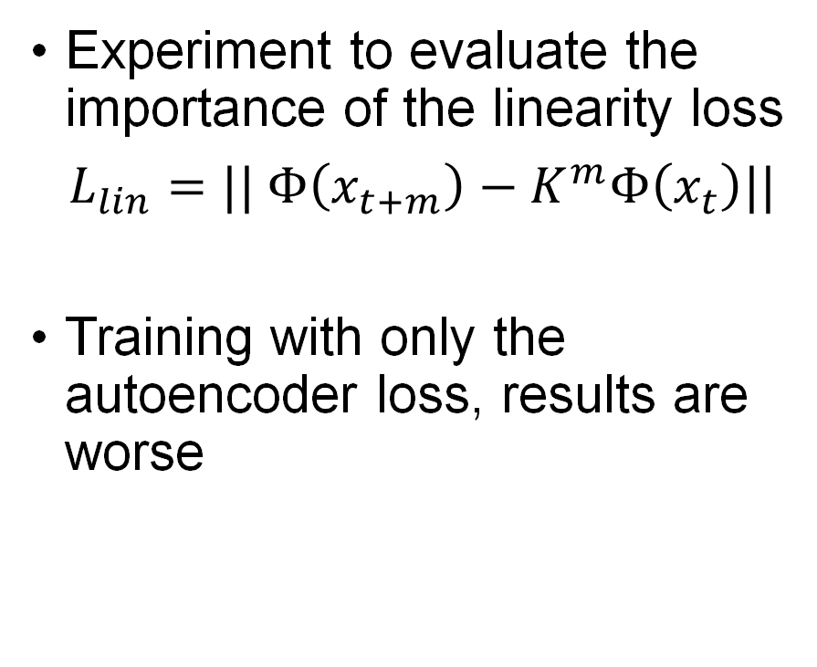
Importance of Linearity Constraint
Experiment to evaluate the importance of the linearity loss
$L_{lin}=|| Φ\left(x_{t+m}\right)−K^{m}Φ\left(x_{t}\right)||$
Training with only the autoencoder loss, results are worse

Slide 22
Conclusions
Major contributions:
Self-supervised learning offers us additional information about multivariate time series dynamics, specifically ECGs and EEGs.
Koopman embeddings are an approach that is grounded in theory of control of dynamical systems, and that proved to be very solid also experimentally.
Major limitations:
Embedding size is an additional hyperparameter, not obvious from the context.
Embedding size is also often bigger than the original size, which leads to more expensive computations.

Slide 23
Bibliography
Y. Yehuda, D. Freedman, K. Radinsky. Self-supervised Classification of Clinical Multivariate Time Series using Time Series Dynamics. DOI: 10.1145/3580305.3599954.
E. A. Maharaj, A. M. Alonso. Discriminant analysis of multivariate time series: Application to diagnosis based on ECG signals. DOI: 10.1016/j.csda.2013.09.006.
P. Bevanda, S. Sosnowski, S. Hirche. Koopman Operator Dynamical Models: Learning, Analysis and Control. DOI: 10.1016/j.arcontrol.2021.09.002.

Slide 24

Thanks for the attention!

